Slide 1
Game Playing
MinMax
Alpha-Beta

Slide 2
Motivation
Why study games?
  Games are fun!
  Historical role in AI
  Studying games teaches us how to deal with other agents trying to foil our plans
  Huge state spaces – Games are hard!
  Nice, clean environment with clear criteria for success

Slide 3
The Simple Case
Chess, checkers, Tic-Tac-Toe, Othello, go …
Two players alternate moves
Zero-sum: one player’s loss is another’s gain
Perfect Information: each player knows the entire game state
Deterministic: no element of chance
Clear set of legal moves
Well-defined outcomes (e.g. win, lose, draw)

Slide 4
More complicated games
Most card games (e.g. Hearts, Bridge, “Belot” …etc.) and Scrabble
  non-deterministic
  lacking in perfect information.
Cooperative games

Slide 5
Game setup
Two players: A and B
A moves first and they take turns until the game is over. Winner gets award, loser gets penalty.
Games as search:
  Initial state: e.g. board configuration of chess
  Successor function: list of (move,state) pairs specifying legal moves.
  Goal test: Is the game finished?
  Utility function: Gives numerical value of terminal states. E.g. win (+1), lose (-1) and draw (0) in tic-tac-toe
A uses search tree to determine next move.

Slide 6
How to Play a Game by Searching
General Scheme
  Consider all legal moves, each of which will lead to some new state of the environment (‘board position’)
  Evaluate each possible resulting board position
  Pick the move which leads to the best board position.
  Wait for your opponent’s move, then repeat.
Key problems
  Representing the ‘board’
  Representing legal next boards
  Evaluating positions
  Looking ahead

Slide 7
Game Trees
Represent the problem space for a game by a tree
  Nodes represent ‘board positions’ (state)
  edges represent legal moves.
Root node is the position in which a decision must be made.
Evaluation function f assigns real-number scores to `board positions.’
Terminal nodes (leaf) represent ways the game could end, labeled with the desirability of that ending (e.g. win/lose/draw or a numerical score)

Slide 8
MAX & MIN Nodes
When I move, I attempt to MAXimize my performance.
When my opponent moves, he attempts to MINimize my performance.
TO REPRESENT THIS:
If we move first, label the root MAX; if our opponent does, label it MIN.
Alternate labels for each successive tree level.
  if the root (level 0) is our turn (MAX), all even levels will represent turns for us (MAX), and all odd ones turns for our opponent (MIN).

Slide 9
Evaluation functions
Evaluations how good a ‘board position’ is
  Based on static features of that board alone
Zero-sum assumption lets us use one function to describe goodness for both players.
  f(n)>0 if we are winning in position n
  f(n)=0 if position n is tied
  f(n)<0 if our opponent is winning in position n
Build using expert knowledge (Heuristic),
  Tic-tac-toe: f(n)=(# of 3 lengths possible for me) - (# possible for you)

Slide 10
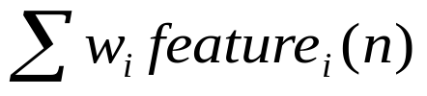
Chess Evaluation Functions
Alan Turing’s
f(n)=(sum of your piece values)- (sum of opponent’s piece values)
More complex: weighted sum
of positional features:
Deep Blue has > 8000 features
(IBM Computer vs. Gary Kasparov)
Pawn | 1.0
Knight | 3.0
Bishop | 3.25
Rook | 5.0
Queen | 9.0
Pieces values for a simple Turing-style evaluation function

Slide 11
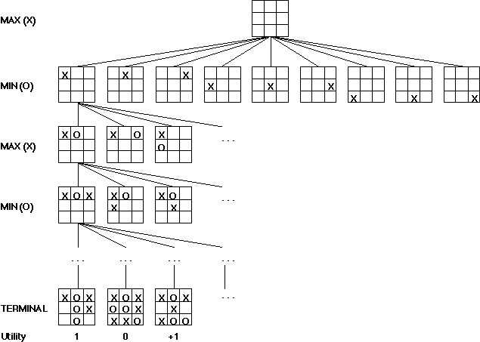
A Partial Game Tree for Tic-Tac-Toe
f(n)=6-6=0
f(n)=8-5=3
f(n)=2
f(n)=3
f(n)=2
f(n)=4
f(n)=2
f(n)=3
f(n)=2
f(n)=3
f(n)=5-5=0
f(n)=6-3=3
f(n)=# of potential three-lines for X –
# of potential three-line for Y if n is
not terminal
f(n)=0 if n is a terminal tie
f(n)=+ ∞ if n is a terminal win
f(n)=- ∞ if n is a terminal loss
-∞
0
+ ∞
Notes:
note that solution requires a move that seems to lose ground: computer doesn’t mind, but people sometimes balk:
331-310/220/320-321-300-311-110*-221-020-031-010-021-000
note that 320 is a useless state because can only go from there back to parent
costs: if equal for all routes then no difference between310 and 220 as second state, but if costs for moving M is 3 and costs for moving C is 1 then is a difference: draw out this part of path clearly and illustrate
331-(2)-310-(1)-321 so cost is 3
331-(4)-220-(3)-321 s0 cost is 7

Slide 12
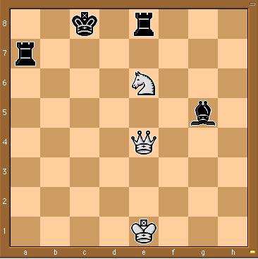
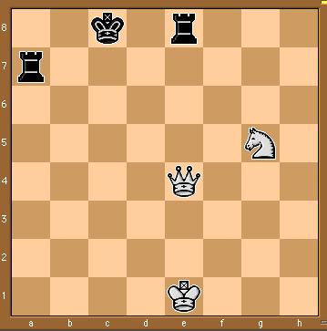
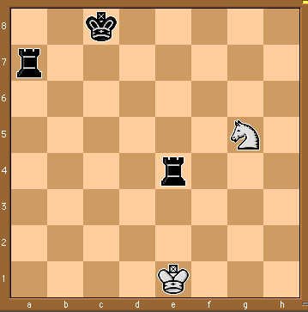
Some Chess Positions and their Evaluations
White to move
f(n)=(9+3)-(5+5+3.25)
=-1.25
… Nxg5??
f(n)=(9+3)-(5+5)
=2
Uh-oh: Rxg4+
f(n)=(3)-(5+5)
=-7
And black may
force checkmate
So, considering our opponent’s possible
responses would be wise.
Notes:
state space defined by initial state and operators, in book, states are implemented as nodes and actions as arcs.
a path represents a sequence of actions that (should) transform the intial world state into a world state that satisfies the goal. **trace on 8’s or VW**
solution: **trace on 8’s or VW**
the right representation can dramatically decrease the size of the state space, as we’ll see with the M&C problem.

Slide 13
MinMax Algorithm
Two-player games with perfect information, the minmax can determine the best move for a player by enumerating (evaluating) the entire game tree.
Player 1 is called Max
  Maximizes result
Player 2 is called Min
  Minimizes opponent’s result

Slide 14
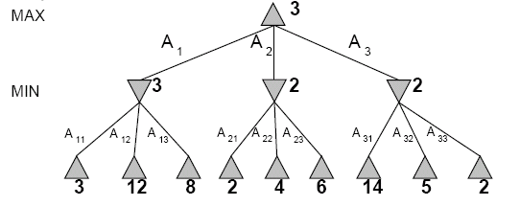
MinMax Example
Perfect play for deterministic games
Idea: choose move to position with highest minimax value
= best achievable payoff against best play
E.g., 2-ply game:

Slide 15
Two-Ply Game Tree

Slide 16
Two-Ply Game Tree

Slide 17
MinMax steps
Int MinMax (state s, int depth, int type)
{
if( terminate(s)) return Eval(s);
if( type == max )
{
for ( child =1, child <= NmbSuccessor(s); child++)
{
value = MinMax(Successor(s, child), depth+1, Min)
if( value > BestScore) BestScore = Value;
}
}
if( type == min )
{
for ( child =1, child <= NmbSuccessor(s); child++)
{
value = MinMax(Successor(s, child), depth+1, Max)
if( value < BestScore) BestScore = Value;
}
}
return BestScore;
}

Slide 18
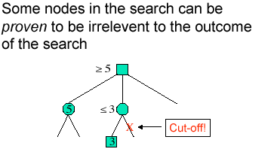
MinMax Analysis
☹
Time Complexity: O(b^{d)}
Space Complexity: O(b*d)
Optimality: Yes
Problem: Game ➔ Resources Limited!
  Time to make an action is limited
Can we do better ? Yes !
How ? Cutting useless branches !
☺
☺

Slide 19
How do we deal with resource limits?
Evaluation function: return an estimate of the expected utility of the game from a given position, i.e.:
  Generate Search Tree up to certain level (i.e.: 4)
Alpha-beta pruning:
  return appropriate minimax decision without exploring entire tree

Slide 20
Alpha-Beta Algorithm
It is based on process of eliminating a branch of the search tree “pruning” the search tree.
It is applied as standard minmax tree:
  it returns the same move as minimax
  prunes away branches that are not necessary to the final decision.

Slide 21
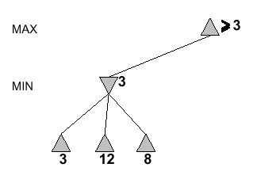
α-β Example

Slide 22
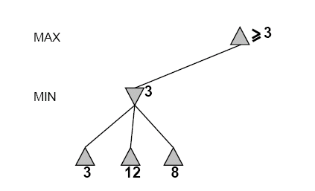
Alpha-Beta Example
[−∞,+∞]
[−∞, +∞]

Slide 23
Alpha-Beta Example (continued)
[3,+∞]
[−∞,3]

Slide 24
Alpha-Beta Example (continued)
[3,+∞]
[−∞,3]

Slide 25
Alpha-Beta Example (continued)
[3,+∞]
[3,3]

Slide 26
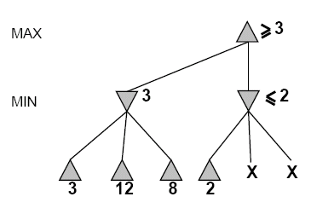
Alpha-Beta Example (continued)
[3,+∞]
[3,3]
[−∞,2]
We don’t need to compute the value at this node.
No matter what it is it can’t effect the value of the root node.

Slide 27
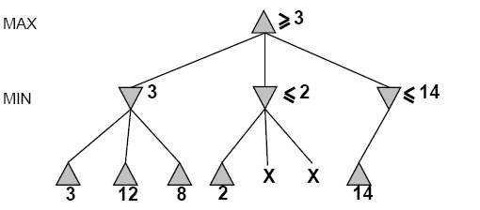
Alpha-Beta Example (continued)
[3,14]
,
[3,3]
[−∞,2]
[−∞,14]

Slide 28
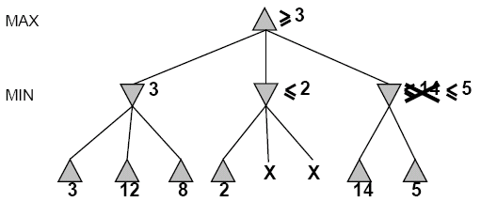

Alpha-Beta Example (continued)
[3,5]
,
[3,3]
[−∞,2]
[−∞,5]

Slide 29
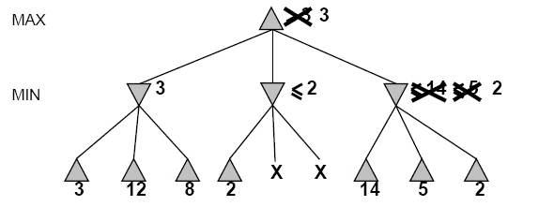
Alpha-Beta Example (continued)
[3,3]
[3,3]
[−∞,2]
[2,2]

Slide 30
Alpha-Beta Example (continued)
[3,3]
[3,3]
[−∞,2]
[2,2]

Slide 31
α-β Algorithm
Int AlphaBeta (state s, int depth, int type, int Alpha, int Beta)
{
if( terminate(s) ) return Eval(s);
if( type == max )
{
for ( child =1, child <= NmbSuccessor(s); child++)
{
value = AlphaBeta(Successor(s, child), depth+1, min, Alpha, Beta)
if( value > Alpha ) Alpha = Value;
if( value >= Beta ) return Beta;
}
return Alpha;
}
if( type == min )
{
for ( child =1, child <= NmbSuccessor(s); child++)
{
value = AlphaBeta(Successor(s, child), depth+1, max, Alpha, Beta)
if( value < Beta ) Beta = Value;
if( value <= Alpha ) return Alpha;
}
return Beta;
}

Slide 32
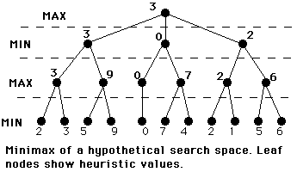
Example Alpha-Beta

Slide 33
Alpha-Beta Analysis
In perfect case (perfect ordering) the depth is decreased twice in time complexity:
➔ O ( b ^{d/2} )
➔ which means that the branching factor (b) is decreased to b

Slide 34
Effectiveness of Alpha-Beta Pruning
Guaranteed to compute same root value as Minimax
Worst case: no pruning, same as Minimax (O(b^{d}))
Best case: when each player’s best move is the first option examined, you examine only O(b^{d/2}) nodes, allowing you to search twice as deep!
For Deep Blue, alpha-beta pruning reduced the average branching factor from 35-40 to 6.

Slide 35
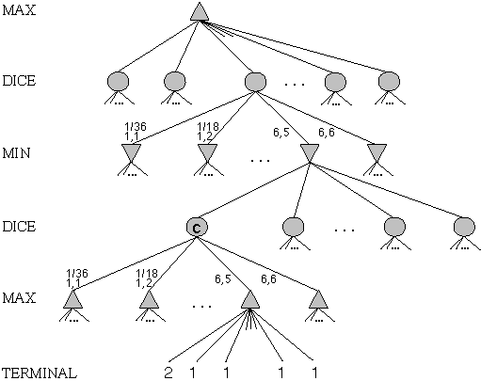
Game Trees with Chance Nodes
Chance nodes (shown as circles) represent random events
For a random event with N outcomes, each chance node has N distinct children; a probability is associated with each
(For 2 dice, there are 21 distinct outcomes)
Use minimax to compute values for MAX and MIN nodes
Use expected values for chance nodes
For chance nodes over a max node, as in C:
expectimax(C) = Sum_{i}(P(d_{i}) * maxvalue(i))
For chance nodes over a min node:
expectimin(C) = Sum_{i}(P(d_{i}) * minvalue(i))
Min
Rolls
Max
Rolls

Slide 36
Conclusion
…Performance Performance !!!
Improve Alpha-Beta to guarantee best-case results
Improve heuristic evaluation function to improve the predictive capabilities of the search
Use parallelism to increase the search depth

Slide 37
The Simple Case
Chess, checkers, Tic-Tac-Toe, Othello, go …
Two players alternate moves
Zero-sum: one player’s loss is another’s gain
Perfect Information: each player knows the entire game state
Deterministic: no element of chance
Clear set of legal moves
Well-defined outcomes (e.g. win, lose, draw)

Slide 38
More complicated games
Most card games (e.g. Hearts, Bridge, “Belot” …etc.) and Scrabble
  non-deterministic
  lacking in perfect information.
Cooperative games

Slide 39
Game setup
Two players: A and B
A moves first and they take turns until the game is over. Winner gets award, loser gets penalty.
Games as search:
  Initial state: e.g. board configuration of chess
  Successor function: list of (move,state) pairs specifying legal moves.
  Goal test: Is the game finished?
  Utility function: Gives numerical value of terminal states. E.g. win (+1), lose (-1) and draw (0) in tic-tac-toe
A uses search tree to determine next move.

Slide 40
How to Play a Game by Searching
General Scheme
  Consider all legal moves, each of which will lead to some new state of the environment (‘board position’)
  Evaluate each possible resulting board position
  Pick the move which leads to the best board position.
  Wait for your opponent’s move, then repeat.
Key problems
  Representing the ‘board’
  Representing legal next boards
  Evaluating positions
  Looking ahead

Slide 41
Game Trees
Represent the problem space for a game by a tree
  Nodes represent ‘board positions’ (state)
  edges represent legal moves.
Root node is the position in which a decision must be made.
Evaluation function f assigns real-number scores to `board positions.’
Terminal nodes (leaf) represent ways the game could end, labeled with the desirability of that ending (e.g. win/lose/draw or a numerical score)

Slide 42
MAX & MIN Nodes
When I move, I attempt to MAXimize my performance.
When my opponent moves, he attempts to MINimize my performance.
TO REPRESENT THIS:
If we move first, label the root MAX; if our opponent does, label it MIN.
Alternate labels for each successive tree level.
  if the root (level 0) is our turn (MAX), all even levels will represent turns for us (MAX), and all odd ones turns for our opponent (MIN).

Slide 43
Evaluation functions
Evaluations how good a ‘board position’ is
  Based on static features of that board alone
Zero-sum assumption lets us use one function to describe goodness for both players.
  f(n)>0 if we are winning in position n
  f(n)=0 if position n is tied
  f(n)<0 if our opponent is winning in position n
Build using expert knowledge (Heuristic),
  Tic-tac-toe: f(n)=(# of 3 lengths possible for me) - (# possible for you)

Slide 44
Chess Evaluation Functions
Alan Turing’s
f(n)=(sum of your piece values)- (sum of opponent’s piece values)
More complex: weighted sum
of positional features:
Deep Blue has > 8000 features
(IBM Computer vs. Gary Kasparov)
Pawn | 1.0
Knight | 3.0
Bishop | 3.25
Rook | 5.0
Queen | 9.0
Pieces values for a simple Turing-style evaluation function

Slide 45
Chinook and Deep Blue
Chinook
  the World Man-Made Checkers Champion, developed at the University of Alberta.
  Competed in human tournaments, earning the right to play for the human world championship, and defeated the best players in the world.
  Play Chinook at (http://www.google.com)
Deep Blue
  Defeated world champion Gary Kasparov 3.5-2.5 in 1997 after losing 4-2 in 1996.
  Uses a parallel array of 1256 special chess-specific processors
  Evaluates 200 billion moves every 3 minutes; 12-ply search depth
  Expert knowledge from an international grandmaster.
  8000 factor evaluation function tuned from hundreds of thousands of grandmaster games

